Slide 1
GZipFilter for Web Application Performance & Load Optimization
Aug 2019

Slide 2
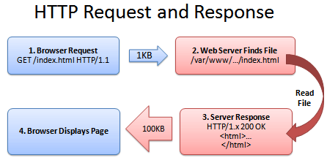
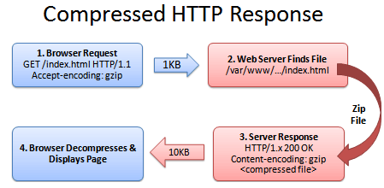
GZipFilter
About GZip Filter :
It is a normal Servlet Filter
Can be implemented in Web Application Framework Level
It Compress the HttpRequests & HttpResponses in perspective of reducing Web Page Load time.
It does Compression over JSPs, .JS, .CSS & .HTML
This Compression is nothing but minification measure to increase Page Speed
As a part of our Navisys-fo application performance improvisation we have tested GZip Filter local which gives a huge & +ve delta change in performance.
It gives more than 50% improvisation in performance on an average.
Implementation Plan is Work In Progress
Normal
GZip

Slide 3
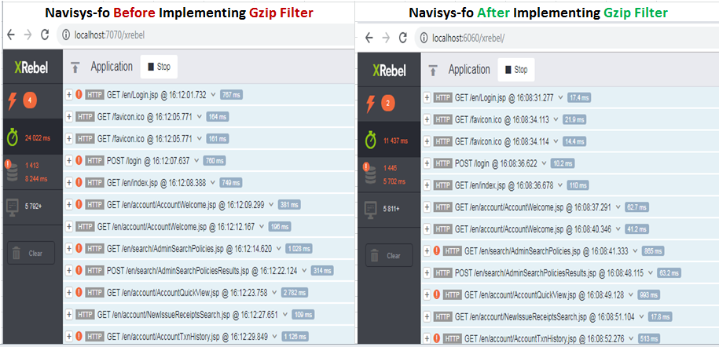
GzipFilter
Implementation Details:
Existing ServletFilter.java needs to be updated with GZip Filter code (few lines of code)
Need to add 2 more new .Java files for Response Wrapping with Compressed encoding.
Servlet Filter Mapping has to be added for .JSP, .JS, .CSS & .HTML
That’s it!

Slide 4
THANK YOU

